Slide 1
Human Recongtion
Bachtobji Amjed
&
Bayoudhi Mohamed
LISI A3-02

Slide 2
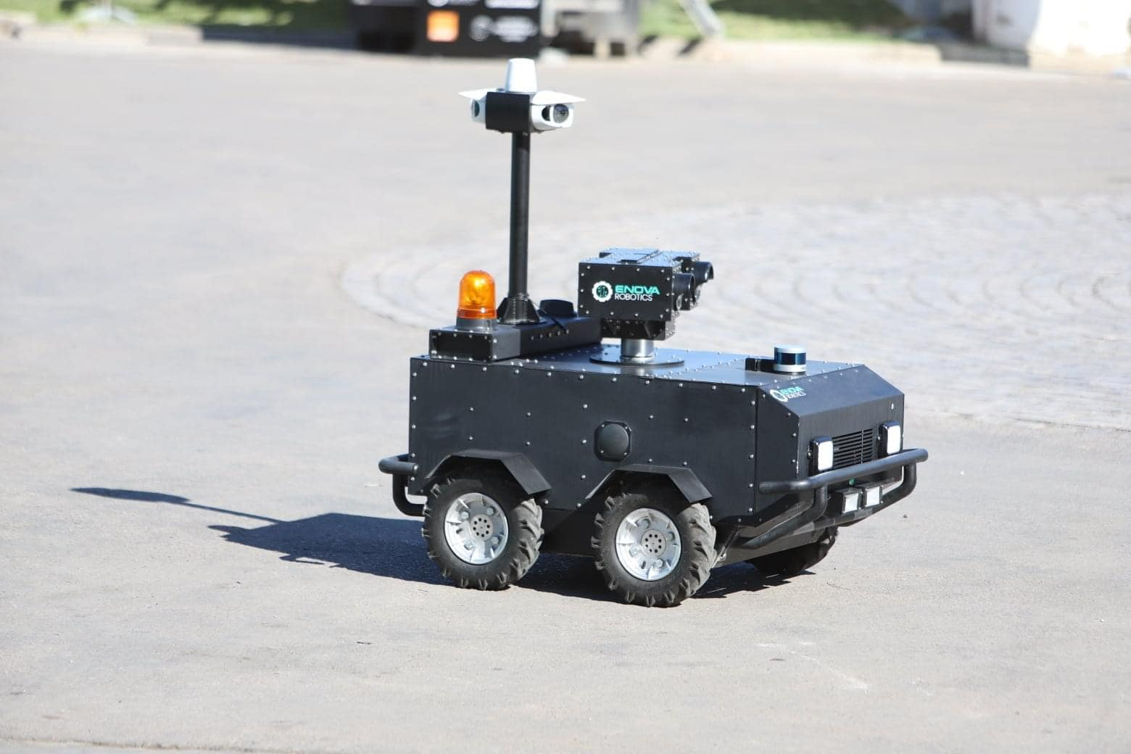
Let’s Get into the context of our project !
Nowadays, Robots are taking the majority of hard works and high-precision works, they are dominating in industrial fields, medical fields and security fields.
Taking the security domain, robots are working as guardians in many companies, it s less risky for human being and more efficient , as an example, we all remember that robot used by the ministry of interior in covid19 – era to impose lockdown on people.
However, anybody can ask himself, how can this
Robot know that the objet standing in front of him
Is a human being? How could it distinguish humans
From other objects?
That s what we are going to talk about in the next
Slides!

Slide 3
TABLE OF CONTENTS
01
02
03
Our Work
Problems & Difficulties
What is Human Recognition?

Slide 4
01
What is Human Recognition?
01

Slide 5
Human activity recognition or HAR is the process of interpreting human motion using computer and machine vison technologies.
Human motion can be interpreted as activities, gestures, or behaviors which are recorded by sensors. The movement data is then translated into action commands for computers to execute and analyze human activity recognition code.

Slide 6
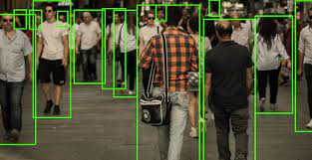
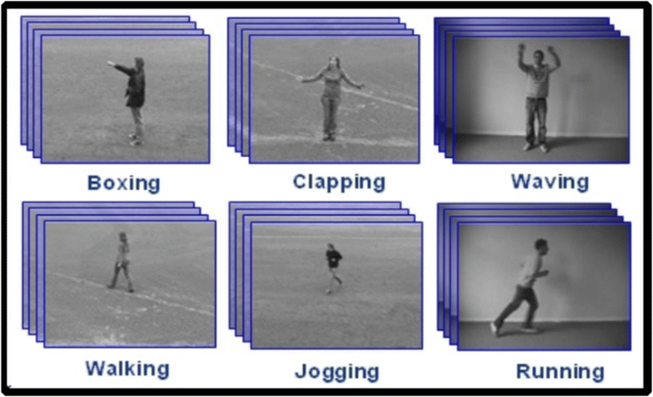
We can distinguish two types of human recogniton:
I) Real Time Human recogniton : in which , robots uses cameras,
detect the object and classify it at the same Time as the example
we took in the beginning, these kinds of robots are pre-trained on
The HR and use Real-Time technologies to do their work
II) Prediction Systems : the type we worked on, it s where we
Train our machine on human recognition, then we insert some
Pictures to test if these machines are able to identify our pictures

Slide 7
Our Work
02

Slide 8
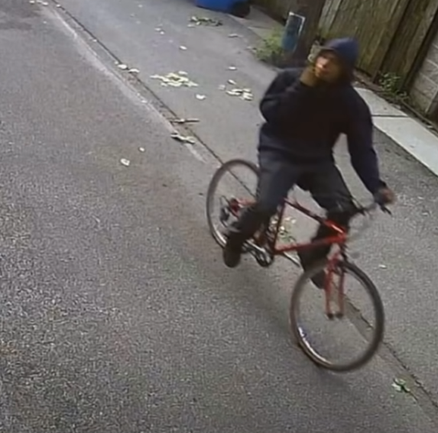
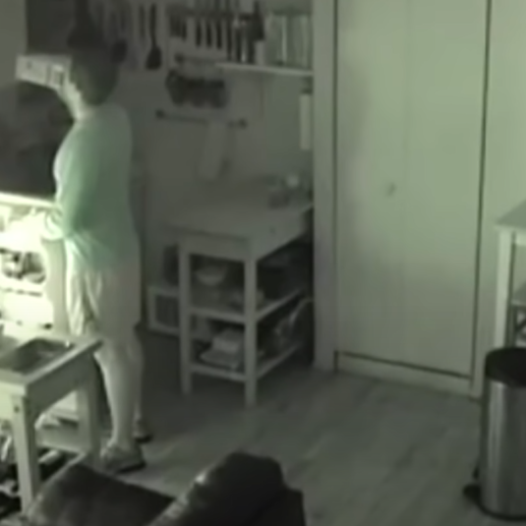
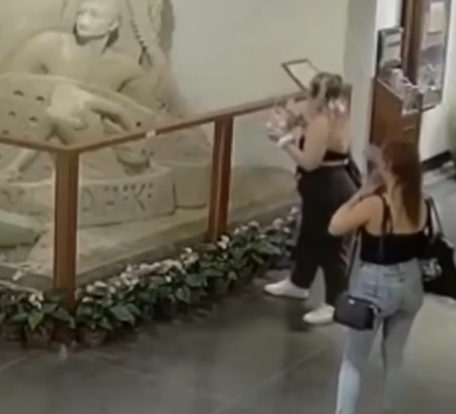
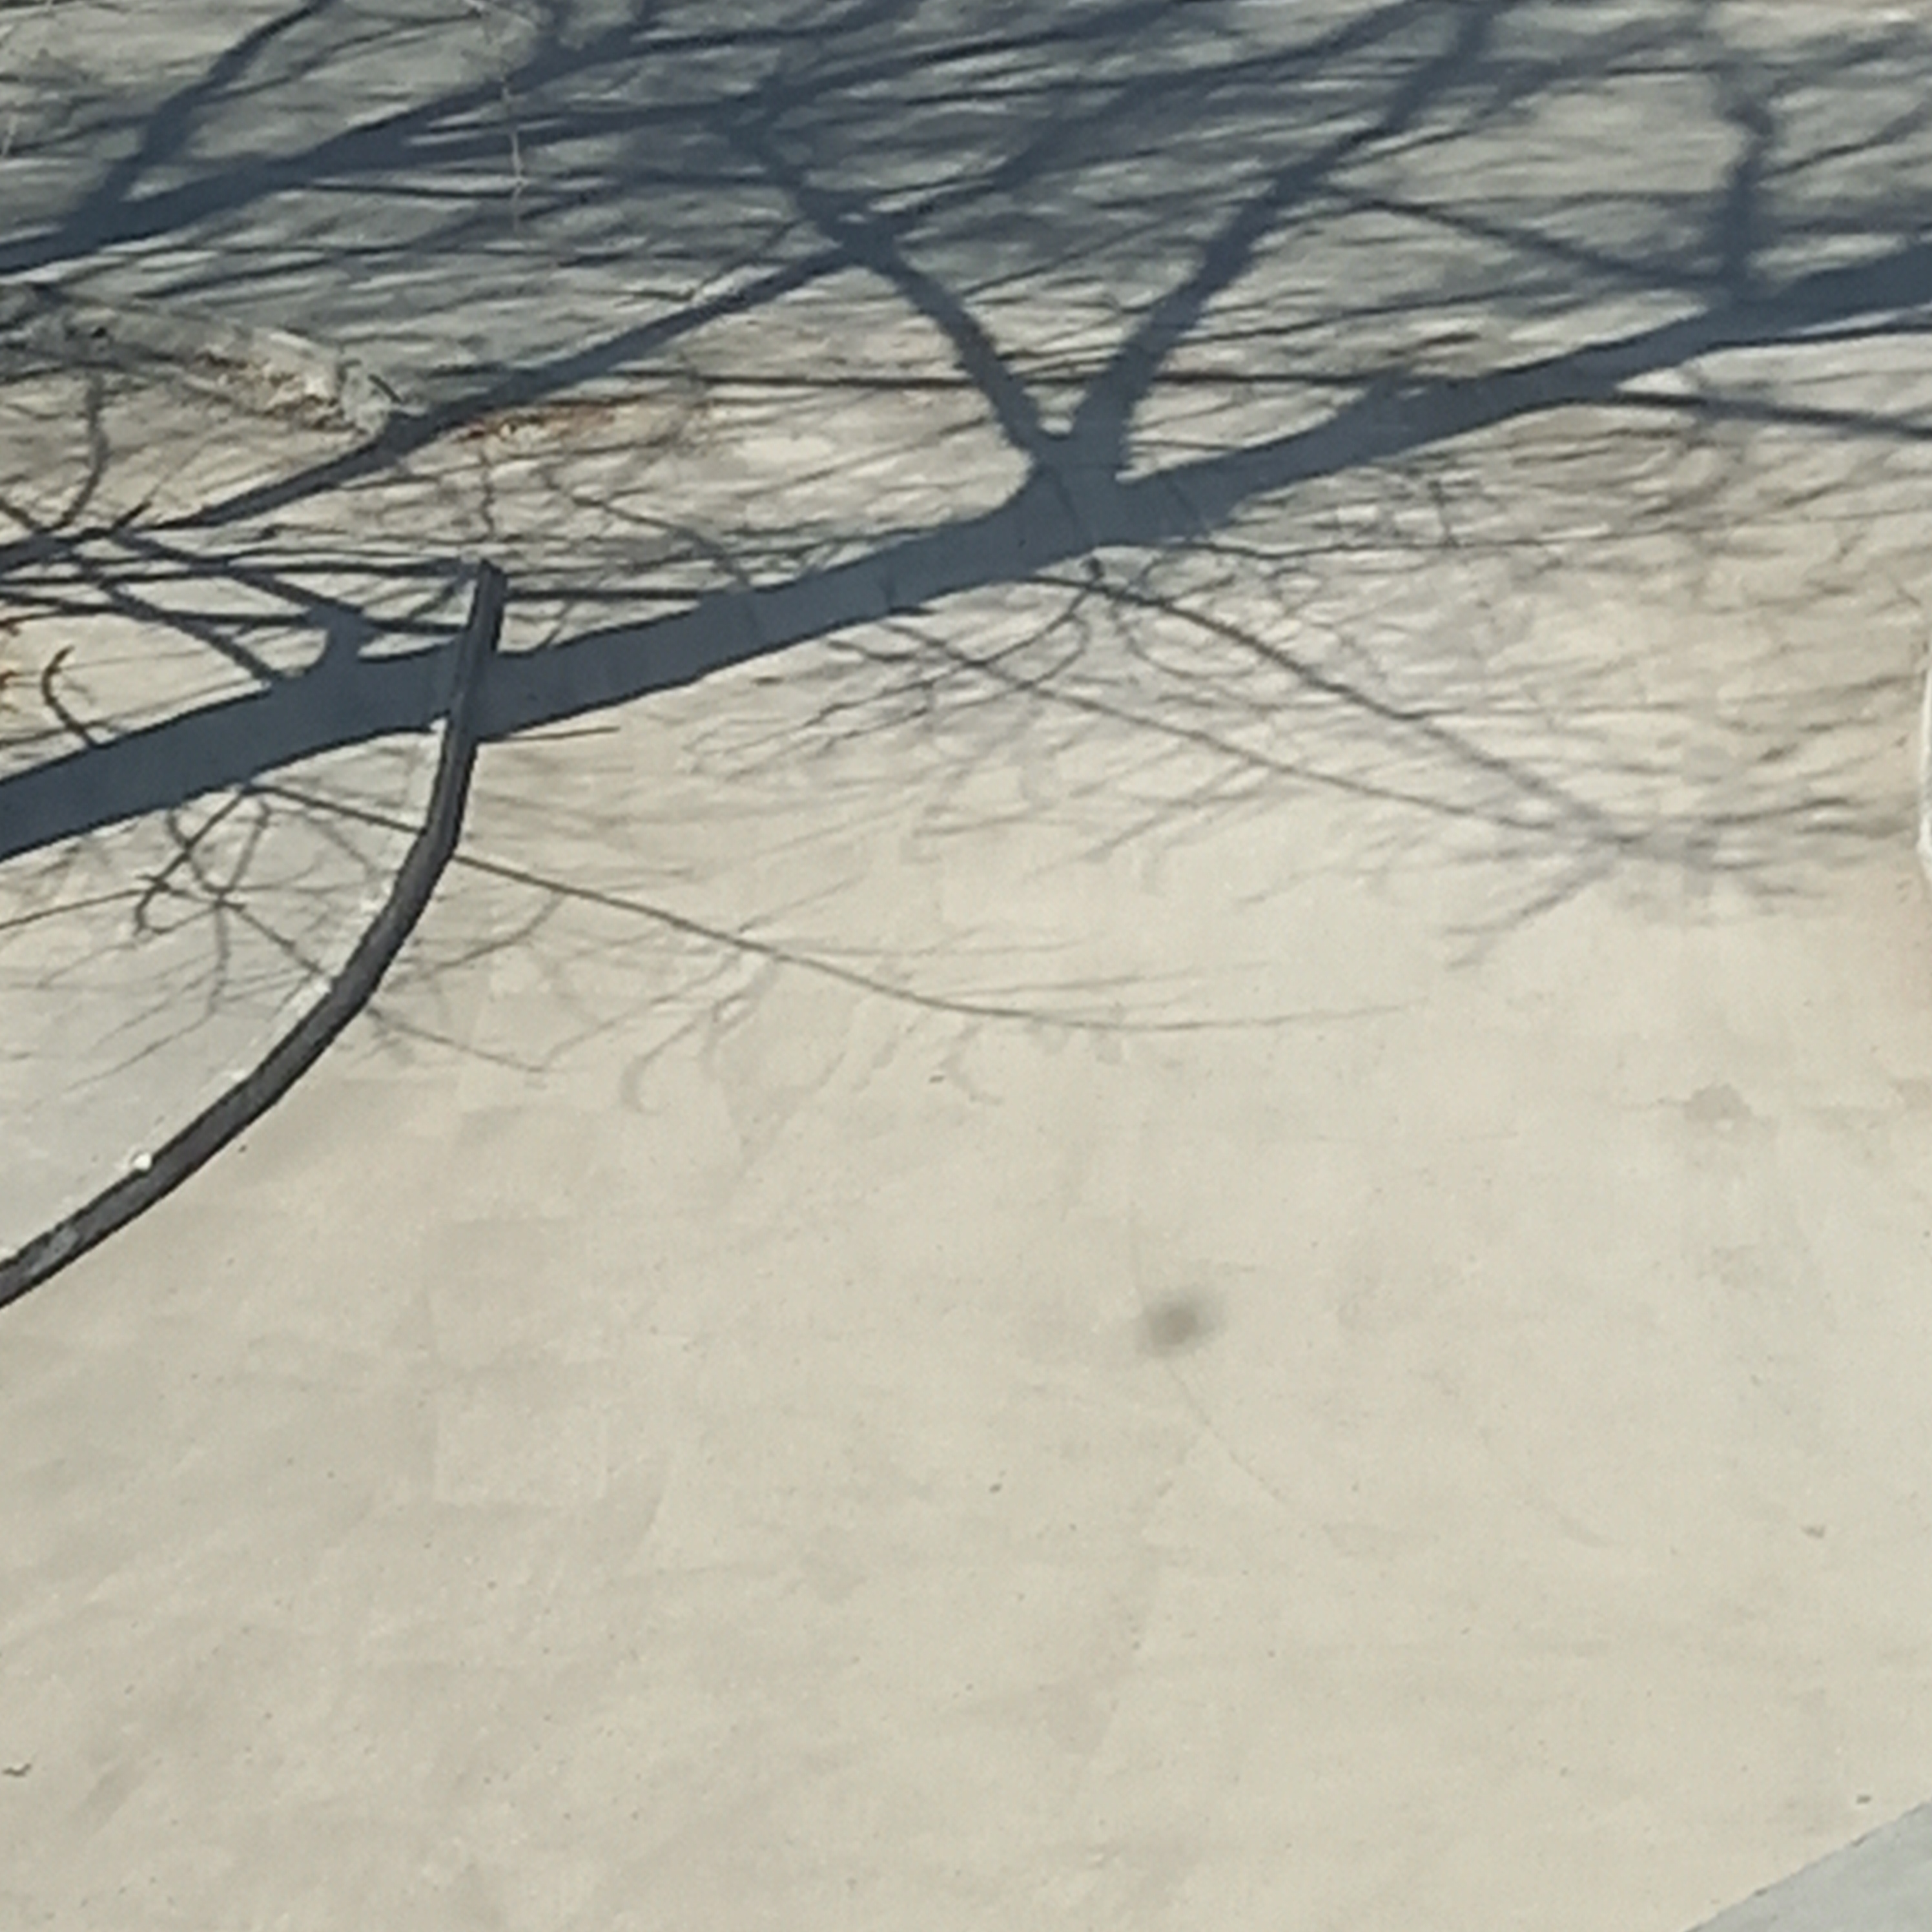
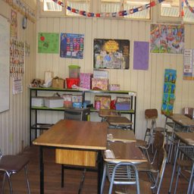
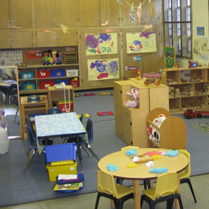
Database and Distribution :
We built a training model, using python libraries (such as TensorFlow, Keras… )
And a collected data base of humans and other objects (table, chairs, empty classrooms…) so that our system could distinguish them later
Here are some pictures of our database:

Slide 9
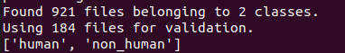
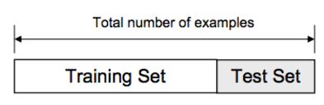
As it s shown below, our database contains 921 pictures from 2 classes : « Human » and « non-human ».
We used 737 picture for training (80%) and 184 for test (20%)

Slide 10

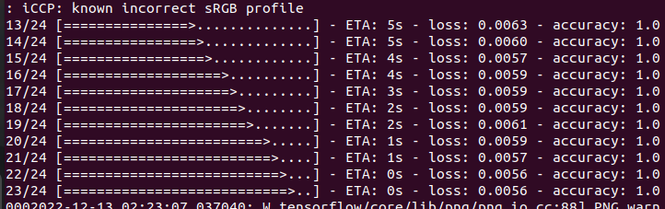
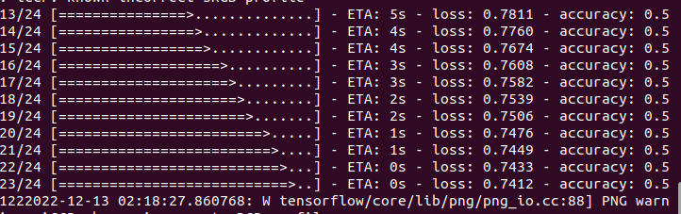
Batch size, epochs :
We chose a batch size equal to 32 as our database dosen’t contain too much date, we gave of model a number of 20 epochs , not too much but enough for this project.
You can see the improvement of accuracy between the 1st and the last epoch.

Slide 11
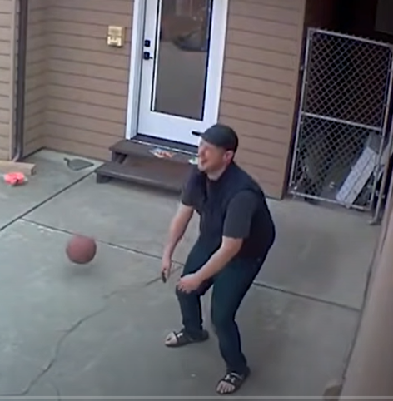
Probability and Prediction :
After training and compiling our model, we tested it with with the following picture and found the following Result and it’s quite exact!

Slide 12
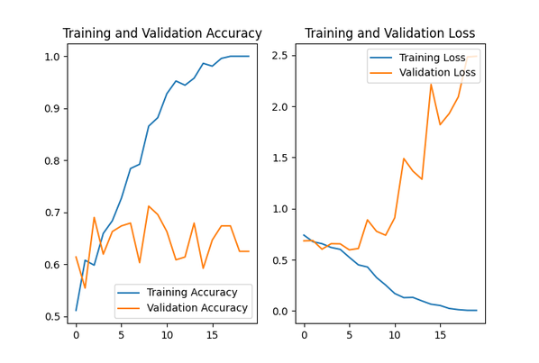
Accuracy and loss:

Slide 13
Problems and Difficulties
03

Slide 14
As any developers, we faced some problems and difficulties such as :
1)We didn’t use a pre-made database, so we had to precise test data and training data by our selves, the solution was a keras function that shuffle data and choose randomly both data and put it in a keras datasets.
2)The Solution above, took us to an other problem, keras datasets can not be handled as pictures in normal treatments , so we had to look for another function able to work with these kind of objects
3) It was our 1st time with ubuntu in development, what made us lose more time to get familiar with.

Slide 15
Thank you for your attention!

